Slide 1
RECONNECT FAMILIES US BORDER REFUGEE PROJECT
David Lincoln
June 2018

Slide 2
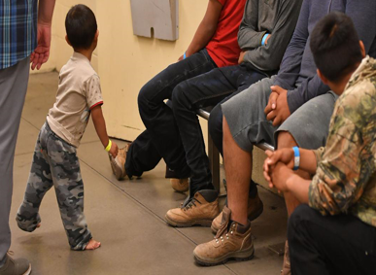
CNN
THE US GOVERNMENT HAS A FAMILY SEPARATION PROBLEM:
They can’t solve it but,
WE CAN!
With your help and support !

Slide 3
OUR GOALs
Reconnect Families with Their Children Wherever They Are Located
Become a Magnet For All PUBLIC Information About US Border Refugees Regardless of Source
Become A Megaphone And TV Channel For Refugees And Their Relatives for Communication with Their Families Anywhere
Offer A Safe And Secure Place For All Those Involved In The Refugee Crisis
Provide Information About Counseling And Available Housing In The Local Areas

Slide 4
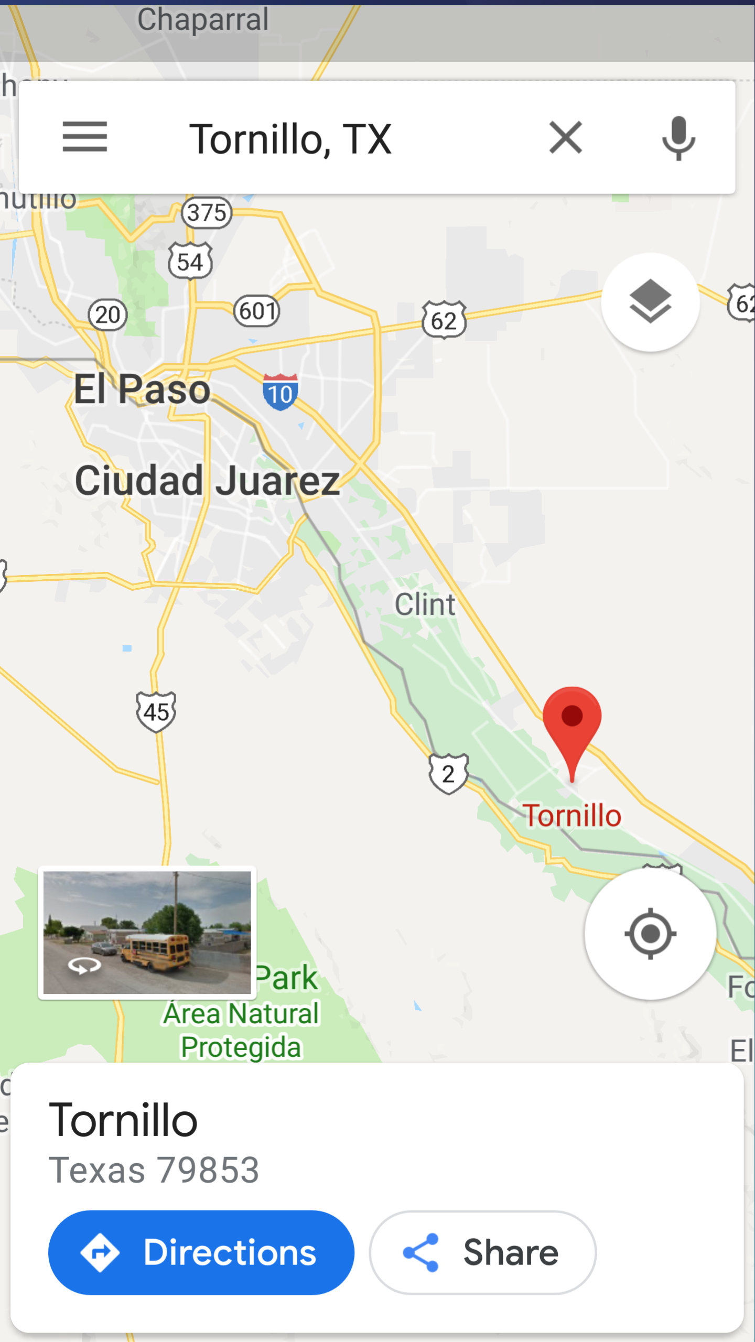
Tornillo Tent city
map location NEAR EL PASO
OUR PLAN
SET UP Bases of Operations in EL PASO & McAllen Tx
Establish Local, Multilingual, Phone Banks At Operations HQ
Route All Communications Through A Single Global Number
Distribute Donated Smartphones To Each Ice Detention Center
Deploy A CROWDMAP Platform
Capture, Display And Analyze All Communications And Plot Their Geolocated Origins And Timestamps
Create Reports And Distribute Leads As Names Are Matched
Mobilize Charities To Make Contact In Detention Centers Or Towns

Slide 5
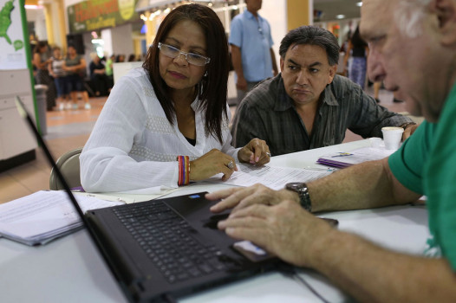
FOCUS
Open 2 Field Offices
REFUGEE ASSISTANCE CENTERS
in MCALLEN & EL PASO TX.
Staffed by EXPERIENCED
LOCAL PEOPLE

Slide 6
PERSONNEL – 2 OFFICES COMBINED
2 office managers 2 IT TECHS 2 data managers 2 data entry techs 2 office interns 2 paralegals 10 volunteers for phone banks
ADMINISTRATIVE SUPPORT 1 Accountant 1 Lawyer 1 PR Publicist 1 Cameraman 1 Employee Relations 1 Govt - Agency Liaison

Slide 7
OUR COMMITMENT
We WILL BE FULLY OPERATIONAL WITHIN ONE MONTH AFTER OUR FUNDING GOALS ($300,000) ARE MET
We Will Begin Connecting Parents With Their Children On The First Day We Have An Electronic Match ON OUR SHORT MESSAGE Connections.

Slide 8
Associate Centers with Established Charities
Social Disaster US Relief Stations;
Lost and found for people
A listening post and counseling center
for people in distress –

Slide 9
PHONE BANKS
One GLOBAL Phone Number- One Text Message Service –
5 Digits
Multi-lingual
Put the Number On T-shirts,
Mugs, Pencils Etc.

Slide 10
LOCAL OPERATORS
Phone Bank Hotline
Staffed by local translators
and bilingual interpreters
Two (on the ground)
LOCAL (s. Texas) phone BANKS

Slide 11
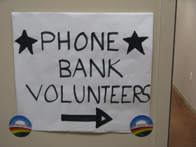
Volunteer Headquarters
Primary Point Of Contact For
Relatives, Social Workers, Media, Lawyers Etc.
Gathering Places For Those In Need Of Assistance Caught Up In The
Immigration Crisis
Advice On The Kinds Of Temporary,
Affordable Housing Available

Slide 12
CONNECTIONS
DIGITAL BULLETIN BOARDs For Leaving And Receiving Messages And Pictures.
TABLETS For Public Use And DONATED CELL PHONES For Personal Use
Private And CONFIDENTIAL DISCUSSION ROOMS
On Line CHAT ROOMS AND DISCUSSION GROUPS
5. Facebook pages for victims friends, family and supportERS
6. Video diaries and case studies
7. Family mailbox or Dropbox for each REFUGEE family
8 Secure communications encrypted with cyber defenses and IT.

Slide 13
INTERACTIVE LIVE WEB TV CHANNELS
Freedom Interactive TV Is The Long-needed Tool For Justice, Prosperity, A Renewed Earth & To Bring All People Together By Letting All People Speak
Scrolling names & contact numbers Just Like Live Sports & Updated Weather Advisories & Alerts!

Slide 14
REFUGEE POPULATION study
Carolina Population Center is a community of outstanding scholars and professionals associated to
create new knowledge about population size, structure, and processes of change
develop new sources of data to support population research
evaluate health information systems and explore ways to improve them for better health outcomes
promote the development and use of innovative methodologies

Slide 15
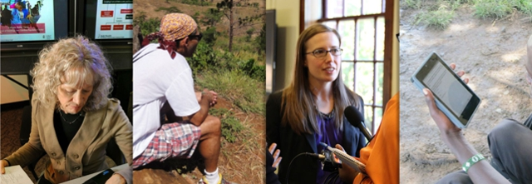
Demographics & Health
University of North Carolina
Build Skills And Capacity And Train The Next Generation Of Scholars
Disseminate Data And Findings To Population And Health Information System Professionals, Policy-makers, And The Public
Carolina Population Center Study
. http://www.cpc.unc.edu/aboutcpc

Slide 16
MULTI-MEDIA DOCUMENTARY
Create a Video Record of Our Ushahidi Deployment & How It Enhances Communication & Mutual Understanding Even in the Midst of Controversy When the Immigration Battle Lines Are Far From Clear.
We hope to Partner with Pennstate Media Who Pioneered the Geospatial Revolution Project.
Their Mission is to Expand Public Knowledge About the History, Applications, Related Privacy & Legal Issues & the Potential Future of Location-based Technologies.
Contact
Project Information: Elaine Brzycki, ejb23@psu.edu
News Media: Lisa Warren, 814-863-9912, luw15@psu.edu
DVD Sales: Penn State Media Sales, 800-770-2111, mediasales@outreach.psu.edu

Slide 17
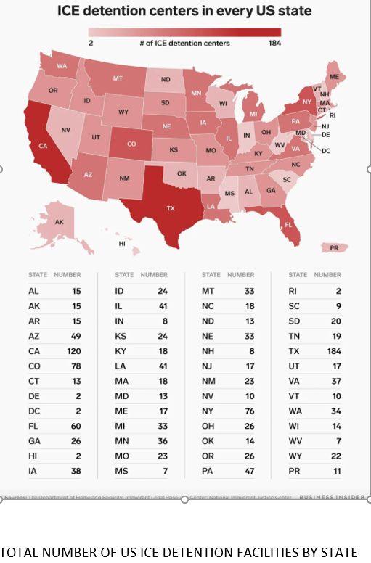
CAPACITY TARGETS
ABLE TO SERVE OVER
10,000 REFUGEES IN 2018
ULTIMATELY SERVING MORE THAN 50,000 REFUGEES PER YEAR FROM 200 ICE
DETENTION CENTERS

Slide 18
COOPERATION & COORDINATION
We Want To Be A Primary Information Resource
A Hub For Local Social Service Agencies And Charities.
A Focal Point For Information Exchange And Planning

Slide 19
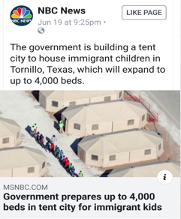
TORNILLO Tent City Aerial View
WE Believe
Separating Children From Their Parents Is Inhumane And Unnecessary
Knowing Where Each Of The Children And Parents Are Will Help Ease The Burden For Everyone
Being Able To Communicate, Exchange Info And Pictures Will Facilitate The Reuniting Of These Families
REFUGEES And Their Relatives Are Already In Touch With Someone
WHAT WE Have To DO IS Voluntarily Capture, ENHANCE And Organize Those Connections.

Slide 20
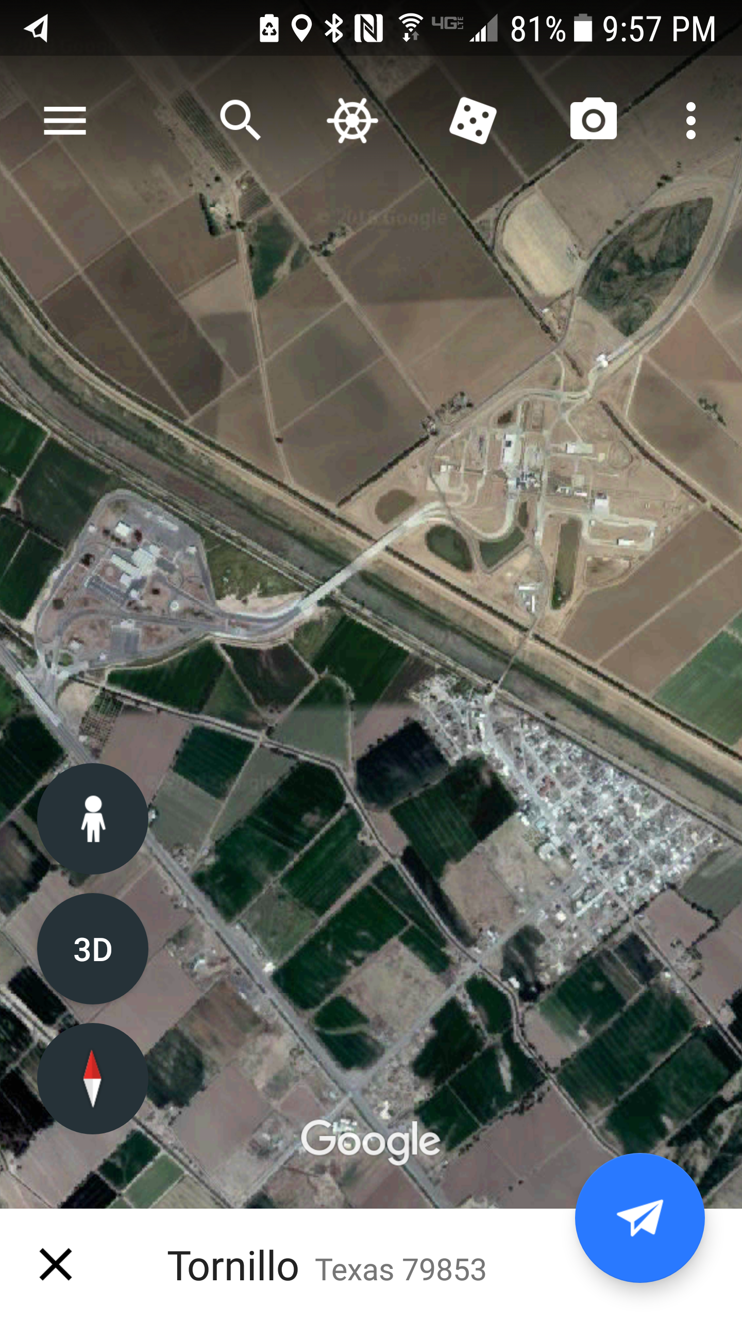
Tornillo Satellite View
OUR CONCERNS –
WE CARE About the Families
Safety and Health!
PSYCHOLOGICAL WELL-BEING – Do They Have Enough Trained And Vetted Psychiatrists At These Centers?
PHYSICAL well-being – How Many Screened Pediatricians Are Available? Are The Military Facilities Contaminated By Chemicals Or Radiation? ARE Pesticides Being Sprayed?
SPIRITUAl well-being – Do They Have Access To Spiritual Leaders Who Can Minister To Them In Their Own Languages

Slide 21
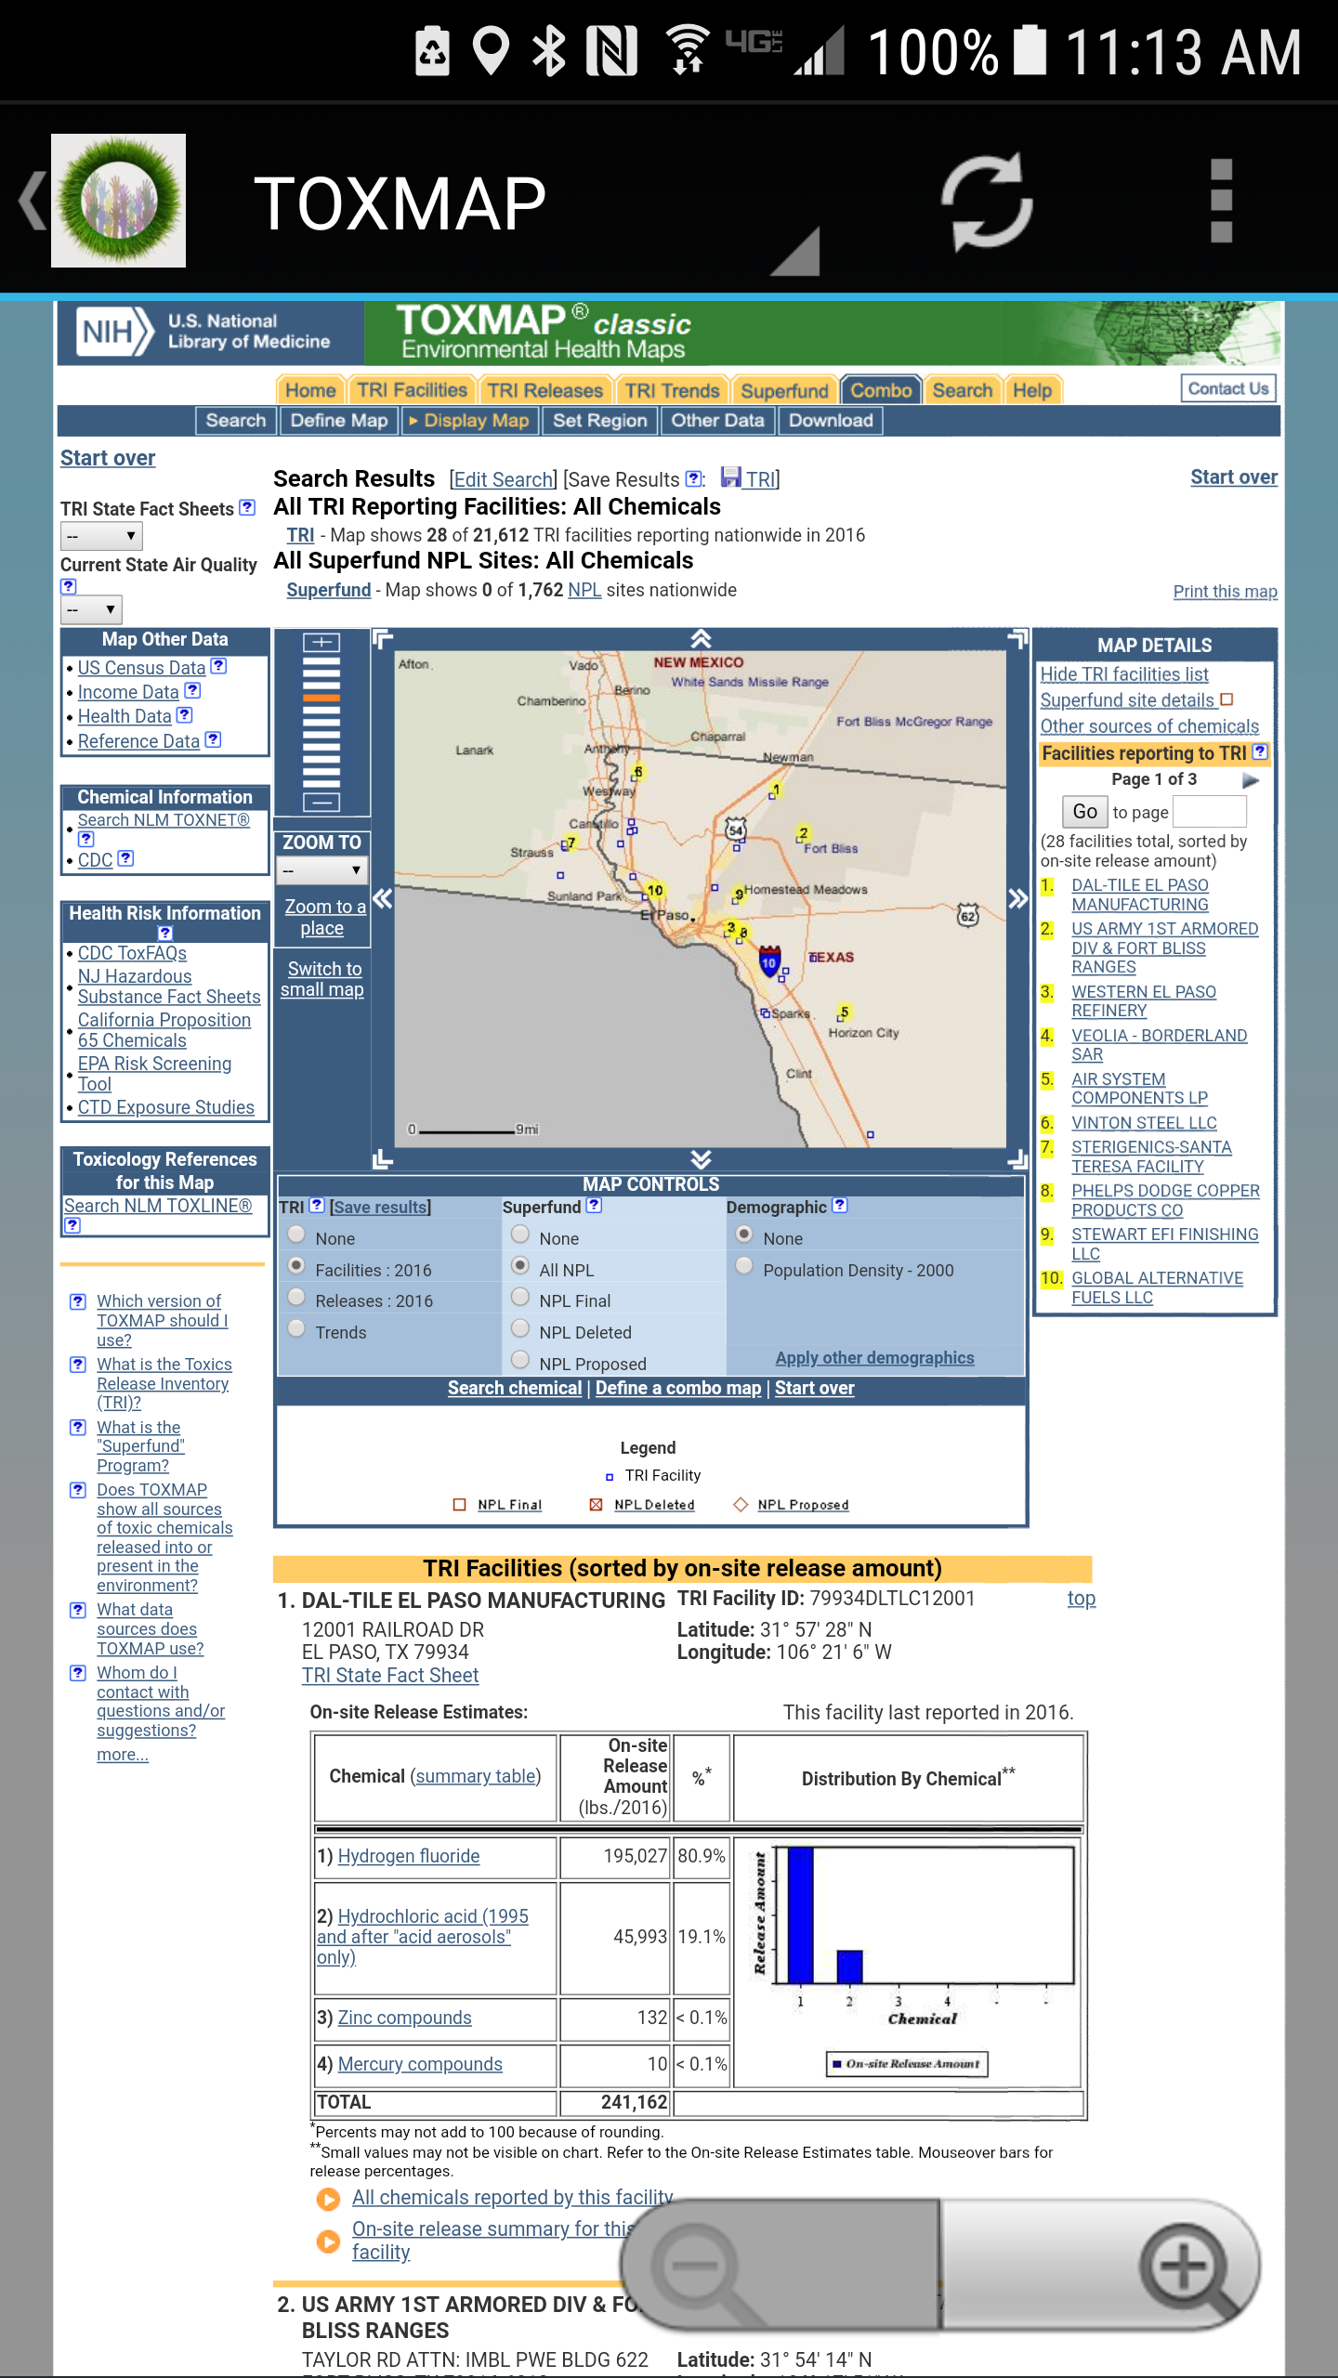
IS IT SAFE? El Paso & Fort Bliss Border Area EMISSIONS Toxic Releases- Worst 2 Sites
Hydrogen fluoride HF > 4 mill. Pounds (all yrs.)
Hydrochloric acid HCl >4 mill pounds (all yrs.) all from DAL-Tile
Lead > 5 mill pounds (all yrs.) - All from the U.S. Army Air Defense Artillery Center at Fort Bliss
Toxmap TRI Sites

Slide 22
Reuters: Study Flags El Paso For High Levels Of Lead Levels In Children April 2017
EL PASO, Texas - A national study released by Reuters shows an alarming number of children in El Paso with high levels of lead in their blood.
An interactive map on an article published by Reuters reveals alarming numbers for the city of El Paso and surrounding areas.

Slide 23
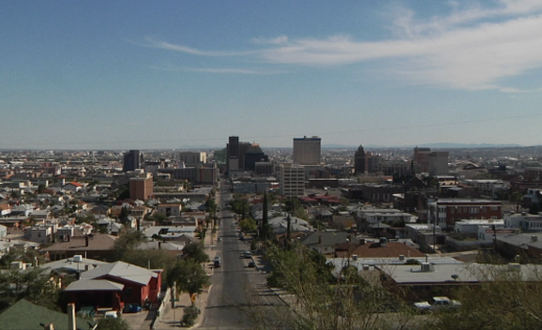
El Paso And Las Cruces Ranks For Worst Air In The Nation
El Paso Among Worst Pollution Levels In State, TXDOT Says
by Simon Williams
Friday, April 20th 2018
EL PASO, Texas (KFOX14) — TxDOT says El Paso is not meeting federal air quality standards because pollutant levels in the air are too high… On their website, they show El Paso as the only Texas city marked as maintenance for PM10,

Slide 24
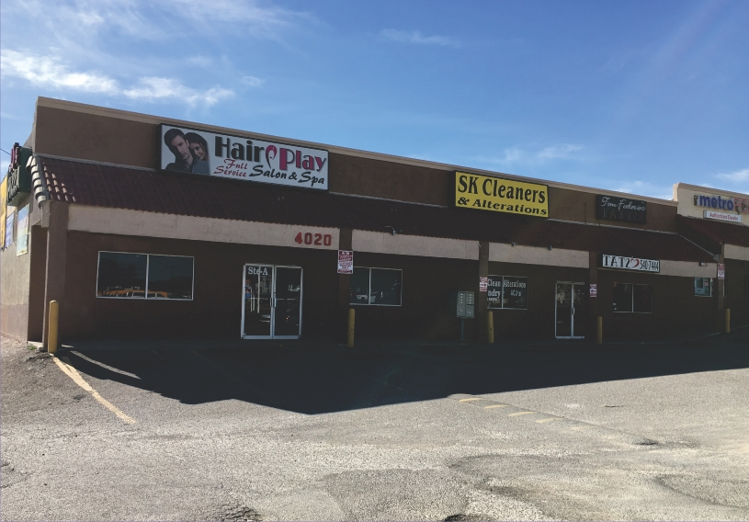
SAFE PLACE Prospective Rental Property
Typical Available Rental Property
In El Paso, Texas

Slide 25
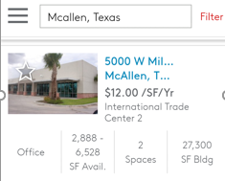
SAFE PLACE Prospective Rental Property
Typical Available Rental Property
In McAllen, Texas

Slide 26
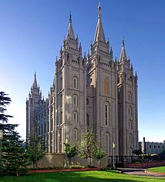
Potential Church Partners
United Methodists - [600 Ministers Called For AG Sessions To Be Ex. Communicated]
Southern Baptists - Convention Just Ended With New President & New Mission Of Social Activism With Support of ME/TOO Movement
The Church Of Jesus Christ Of Latter-day Saints (LDS Church)
Catholic Charities - www.Catholiccharitiesusa .Org Pope Condemns Family Separation Policy

Slide 27
LEGAL HELP
Refugee and Immigrant Center for Education and Legal Services (RAICES) https://www.raicestexas.org/
American Civil Liberties Union ACLU https://www.aclu.org/issues/immigrants-rights
International Rescue Committee (IRC) https://www.rescue.org
Legal Match http://www.legalmatch.com/law-library/article/political-asylum-and-refugees.html

Slide 28
Face-to-face contact
Human Rights and Constitutional Law Foundation (CHRCL) - Peter Schey - This Lawyer Has 100 Volunteer Lawyers Entering Immigrant Detention Facilities Across the US Under Supreme Court FLORES Settlement Decree https://www.centerforhumanrights.org/
San Antonio Interfaith Welcome Coalition -
Sister Sharon Altendorf
Catholic Charities ot the Rio Grande Valley –
Humanitarian Respite Center
Sacred Heart Refuge – Sister Norma Pimentel Exec Dir

Slide 29
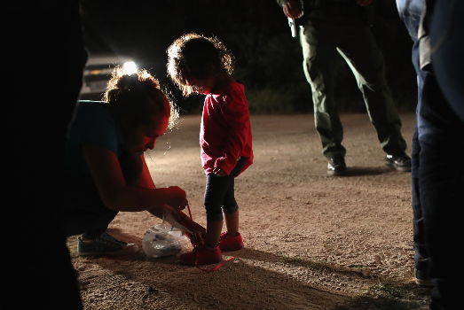
NGOS MOST INVOLVED
Kids In Need Of Defense (KIND) – Megan McKenna
Texas Civil Rights Project (TCRP) –Zenen Jaimes Perez, Communications Director
Refugee and Immigrant Center for Education and Legal Services (RAICES) Michelle Garza, Assoc Exec Dir
Office of Refugee Resettlement (ORR) 1-800 number
Asylum Seeker Advocacy Project (ASAP)
https://www.vice.com/en_uk/article/435mqd/how-charities-are-trying-to-reunite-separated-immigrant-families

Slide 30
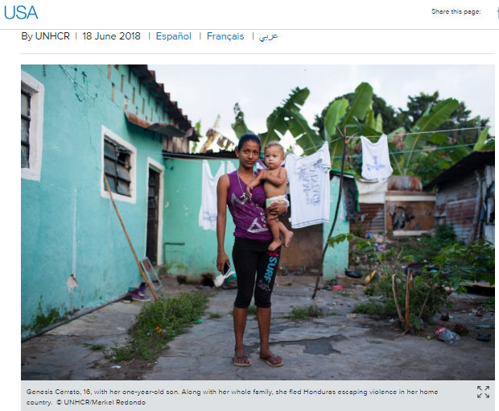
United Nations Potential Partners
UNHCR- United Nations High Commission On Refugees Relief Agency UNHCR Urges Family Unity At Southern US Border http://www.unhcr.org/en-us/news/press/2018/6/5b27fea84/unhcr-urges-family-unity-southern-border.html. June 19th 2018
UNICEF-UNITED NATIONS Intl CHILDREN'S EMERGENCY FUND
U.S. Fund for UNICEF - Official Site
https://www.unicefusa.org

Slide 31
Priyanka Chopra Appointed UNICEF Goodwill Ambassador for Stellar Work in Child Rights December 2016
Actress Priyanka Chopra, An Indian Star With A Global Fan Following, Was Named UNICEF Goodwill Ambassador At A Ceremony In New York Yesterday. ..
The 34-year-old, Who Has Been Donating A Tenth Of Her Salary To The Cause Of Women’s Education, Safety And Empowerment Through Her Ngo, The Priyanka Chopra Foundation For Health And Education,

Slide 32
Ben Stiller Named UN Goodwill Ambassador POSTED 8:58 AM, JULY 2, 2018, BY CNN WIRE
Ben Stiller’s Latest Role Will Have the Actor
Advocating on Behalf of Refugees.
Stiller Has Been Named a Goodwill Ambassador by UNHCR, - UN Refugee Agency
Stiller’s Appointment Comes on the Heels of a Trip He Took to Guatemala Where He Met with People Who Have Been Forced to Flee Their Homes Due to Violence, the Agency Said.

Slide 33
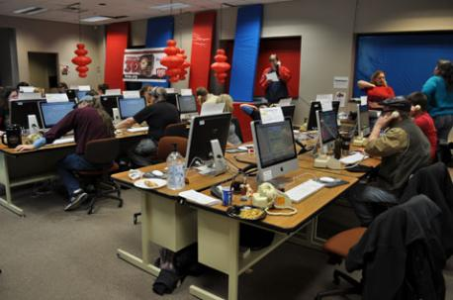
Software platform –Ushahidi
DEPLOYED OVER 125,000 TIMES IN 160 COUNTRIES
USHAHIDI, INC IS A NON-PROFIT TECHNOLOGY COMPANY
STAFF IN NINE COUNTRIES
free, OPEN SOURCED – SECURE PLATFORM
Mission – help marginalized people raise their voice
Help Those who serve them to listen and respond better
https://www.ushahidi.com. see YouTube videos or https://en.m.wikipedia.org/wiki/Ushahidi

Slide 34
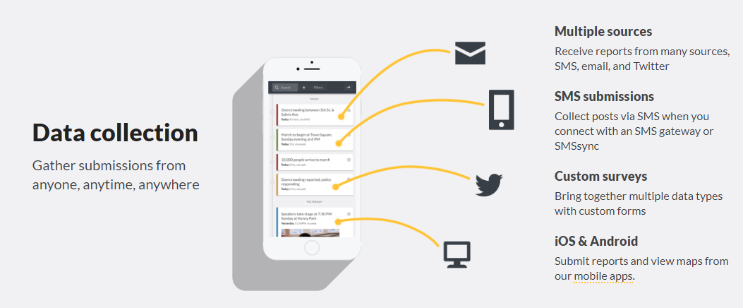
USHAHIDI FEATURES

Slide 35
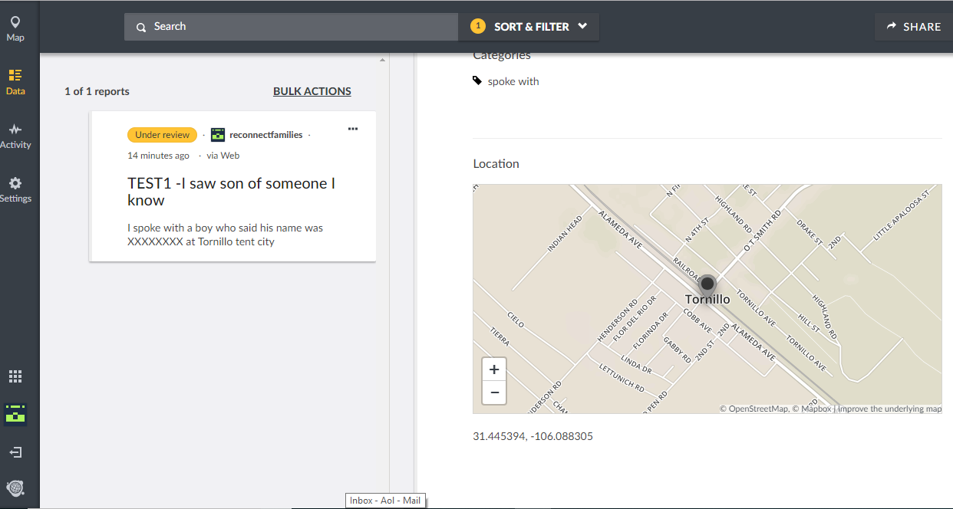
RECONNECT FAMILIES- SOFTWARE TRIAL SUCCESS
Integrates Reports & Geography
Geolocates All SMS, Tweets, Emails, Calls, Text Messages. Records And Timestamps All Communications

Slide 36
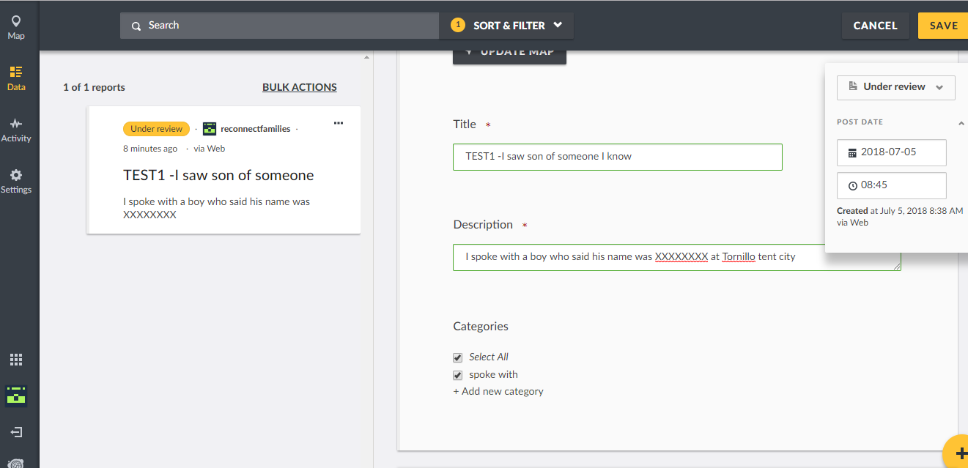
Easy Archiving, Editing & Retrieval

Slide 37
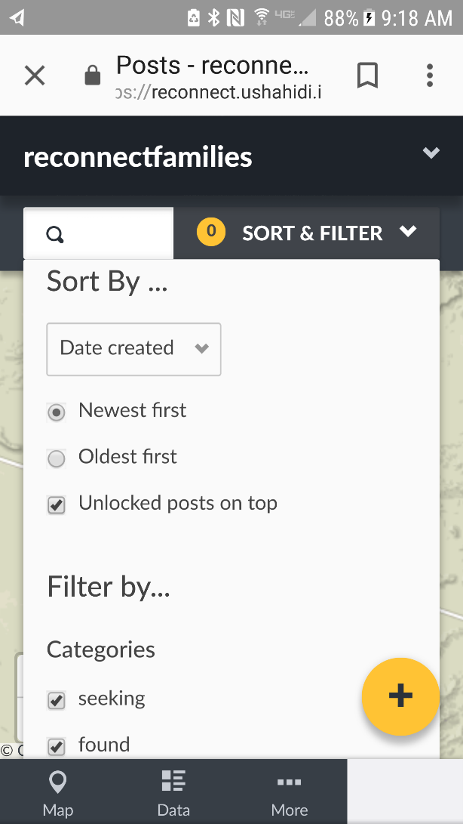
Works On Most Computers or Smartphones
Cloud-based; No Downloads Required
Hands-on Custom Categorization
& Key Words
Built In -Search & Analysis
Verification Function
Displays & Edits on Phones

Slide 38
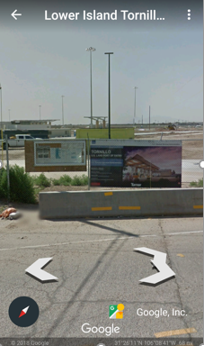
Tornillo Border Control
Directions?
The CROWDMAP Platform links directly to Google Maps, Google Earth and Google Street View among others.
You can locate any center and we can provide directions to that location from our website to your smartphone.
Google Street View

Slide 39
Est. Gov. Costs Per Child
$775 per child/ per day
$5425 per child/ per week
$1.5 mill per 2000 children/ per day
$10 mill per 2000 children/ per week

